Slide 1






INTEGRATION PATTERNS IN MODULAR MONOLITH APPLICATIONS
Follow me on Twitter
Halil İbrahim KALKAN
Volosoft, Co-founder
@hibrahimkalkan
@hikalkan

Slide 2

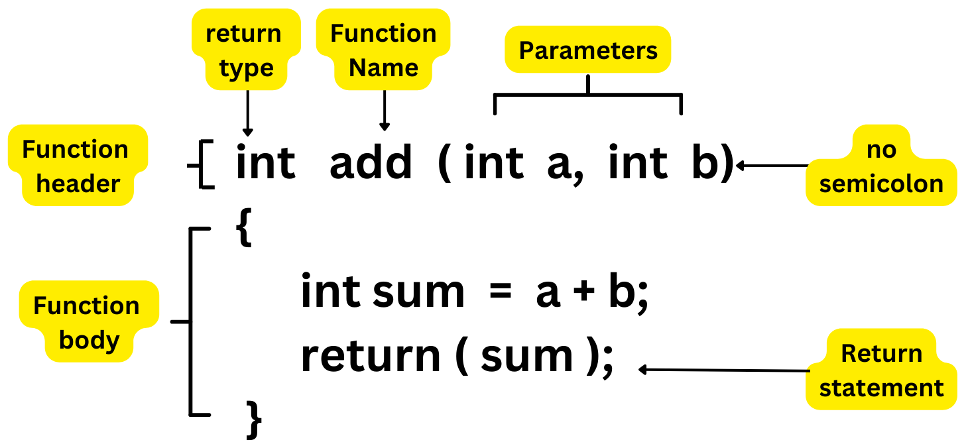
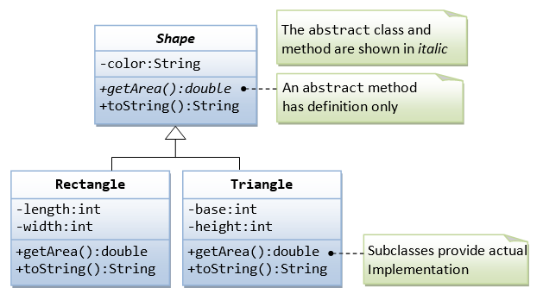

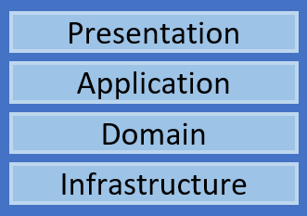
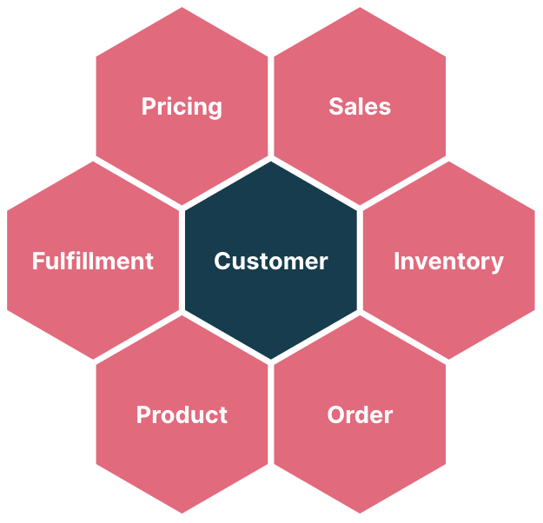
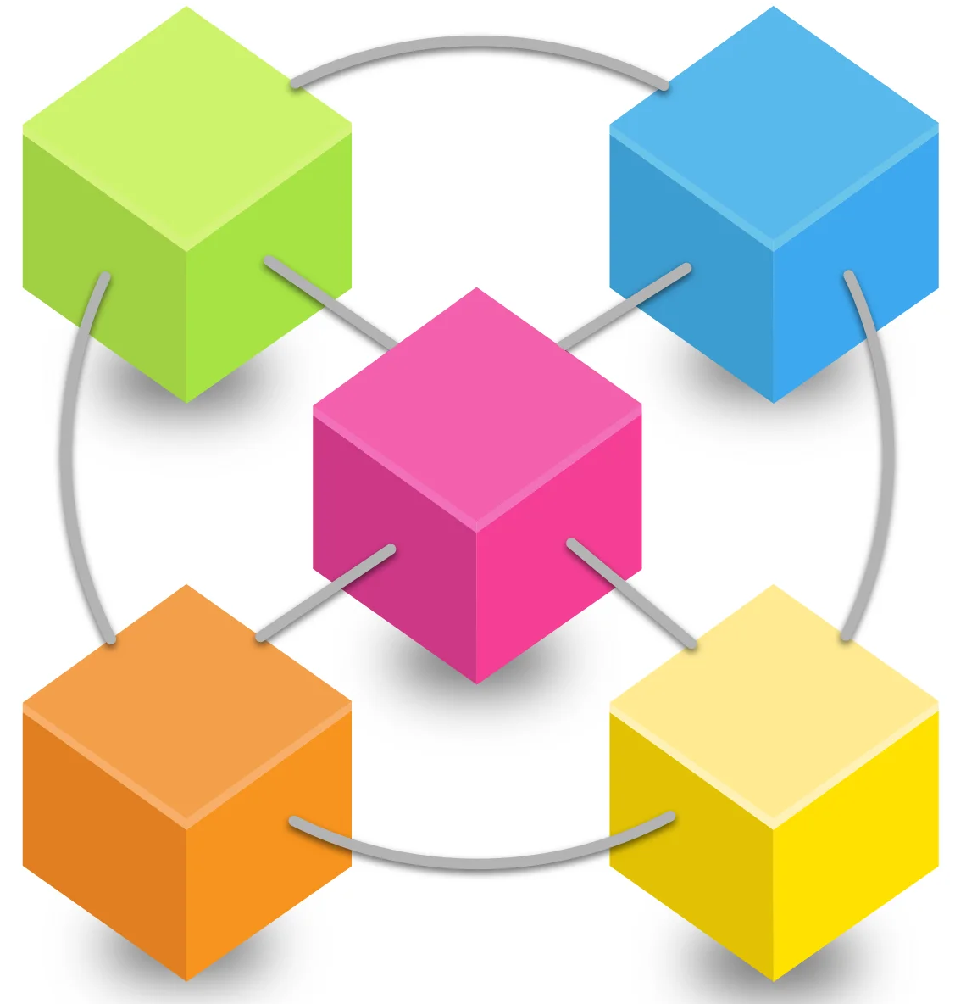
A BRIEF HISTORY OF A DEVELOPER
HTML, CSS, JS
MVC, Razor Pages
REST API
Databases
Authentication
Language int, bool, if, for, while
Parameters
Return values
Overload
SOLID Principles
Design Patterns
int main() {
“Hello World”
}
multiple functions
object oriented programming
single-layer web application
n-layer architecture
modular monolith
microservices
Clean Architecture
Domain Driven Design
Bounded Contexts
Integration Patterns
Docker, Kubernetes
API Gateway
Communication Patterns
Distributed Transactions
DevOps

Slide 3
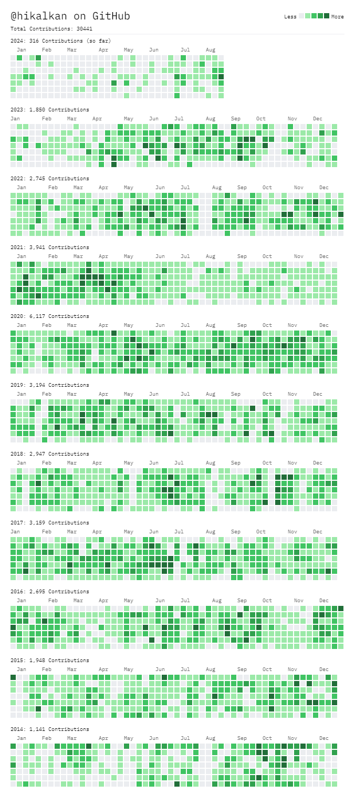







ABOUT ME: HALİL İBRAHİM KALKAN
1997, Started programming (at 14 years old, with Turbo Pascal)
2003-2007, Computer Engineering
2007 - 2015: Software developer, software architect, team leader
2013 - ∞: Lead developer of the open source ABP Framework
2016 - ∞: Co-founder, software architect
Multi-threading, distributed/microservice systems, OOP, DDD, software architectures.. etc.
Still active coder, open-source contributor
30,000+ total contributions on GitHub

Slide 4
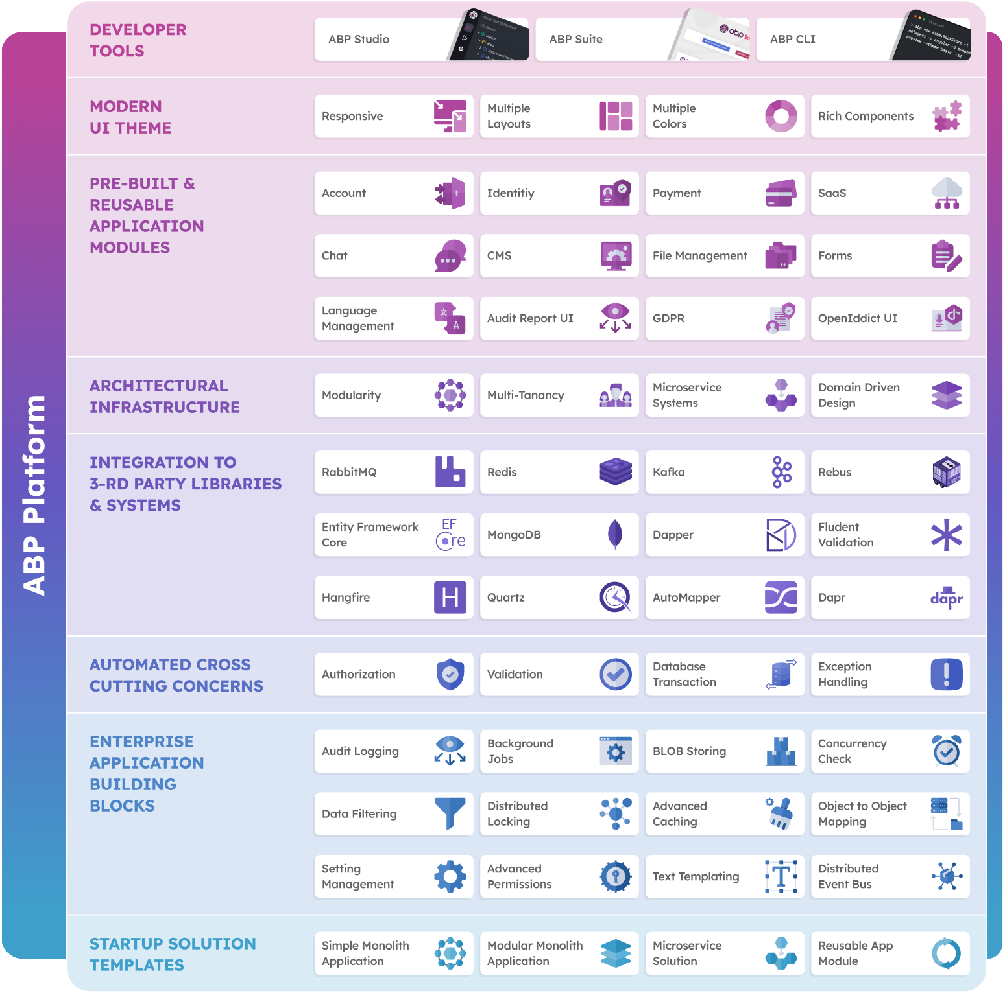
THE ABP PLATFORM
30 Reusable application modules
All modules;
Supports EF Core & MongoDB
Supports MVC, Blazor, Angular UI
Supports modular monolith & microservice scenarios
Supports tiered architecture
Extensible & customizable
Fully layered
Independent of any business
Independent from each other
Good test coverage

Slide 5

AGENDA
Why modularity?
Architectural options - Database - Codebase - User Interface
Integration - Designing module dependencies - Communication patterns - Transaction management
Specialized modules
Best practices
Migrating to microservices

Slide 6

WHY MODULARITY?
Reducing & managing code complexity
On-premise modular deployment
Migrating to microservices later

Slide 7

REDUCING AND MANAGING CODE COMPLEXITY
When you have - A large system with multiple sub-domains - Multiple teams and developers
Smaller modules compose a large solution - Easier to understand and develop manage individual modules - Easier to find & fix problems (!)
Develop, test and deploy independently

Slide 8

ON-PREMISE MODULAR DEPLOYMENT
Deliver only the modules they have purchased - Requires a completely loose coupled design - The system should work when you remove a module - Can load modules as plug-ins (on application launch time)
Alternative: Enable/disable features on runtime - Obfuscating DLLs

Slide 9
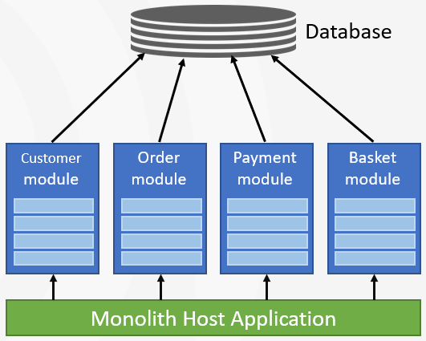
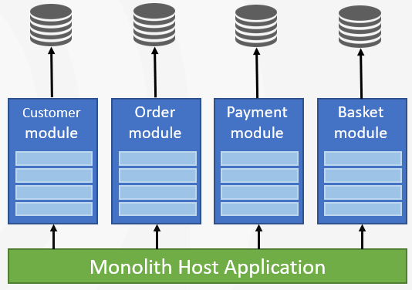
DATABASE ARCHITECTURE OPTIONS
Single (Shared) Database
Separate Module Databases

Slide 10
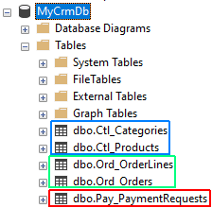
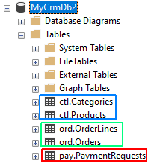
DATABASE ARCHITECTURE: SINGLE DATABASE
Separate by Table Prefix
Separate by Database Schema

Slide 11
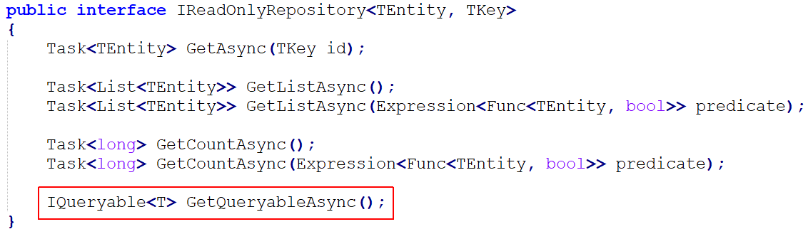
DATABASE ARCHITECTURE: SINGLE DATABASE
Use separate connection strings for each module;
Server=localhost;Database=MyCrmDb2;User Id=catalog_module;Password=1q2w3E*;
Server=localhost;Database=MyCrmDb2;User Id=order_module;Password=abcABC*;
Data access approaches;
Access to only own schema
Manipulate own schema & Read-only access to others

Slide 12
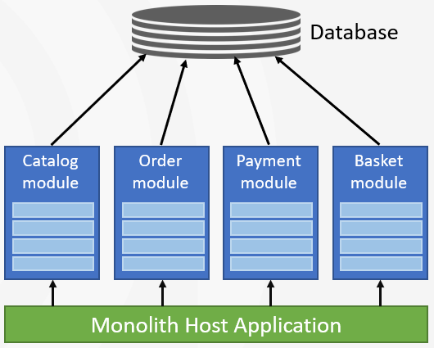
DATABASE ARCHITECTURE: SINGLE DATABASE
Pros:
Easier to build, maintain, manage and backup the database
Possible to make multi-module table JOIN or lookup operations
Possible to ensure database level transactions
Cons:
Easier to break modularity
Schema changes of a module may require change on others (on read-only access)
All modules use the same DBMS technology
Scaling independently for a module is not possible

Slide 13
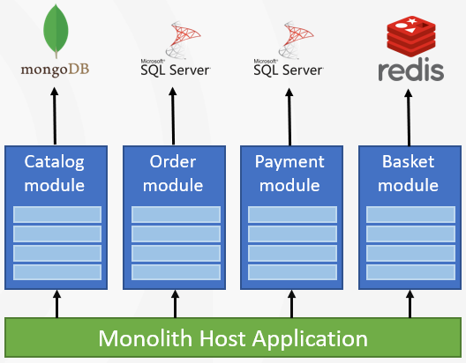
DATABASE ARCHITECTURE: SEPARATE DATABASES
Pros:
Best data isolation
Use Best DBMS technology for each module
Scale databases independently
More microservice ready
Cons:
Hard to prepare multi-module reports
Hard to ensure database level transactions
Hard to set up, manage, maintain and backup
Hybrid: Separate databases only when needed!

Slide 14
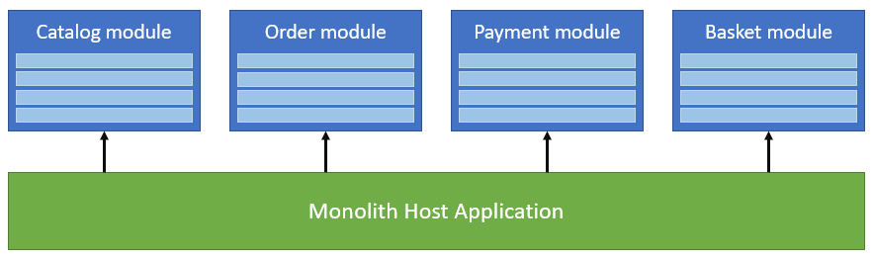
CODEBASE STRUCTURE

Slide 15
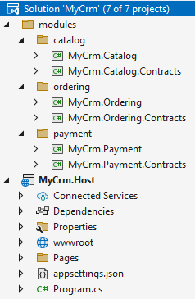
CODEBASE STRUCTURE: SINGLE SOLUTION
Easier and faster to develop and test
Easier to catch build errors & breaking changes
Good for small teams
Good if a developer working on multiple projects

Slide 16
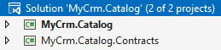
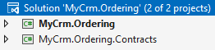
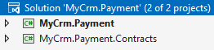
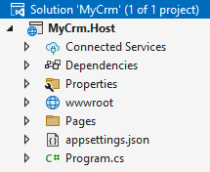
CODEBASE STRUCTURE: MULTIPLE SOLUTIONS

Slide 17
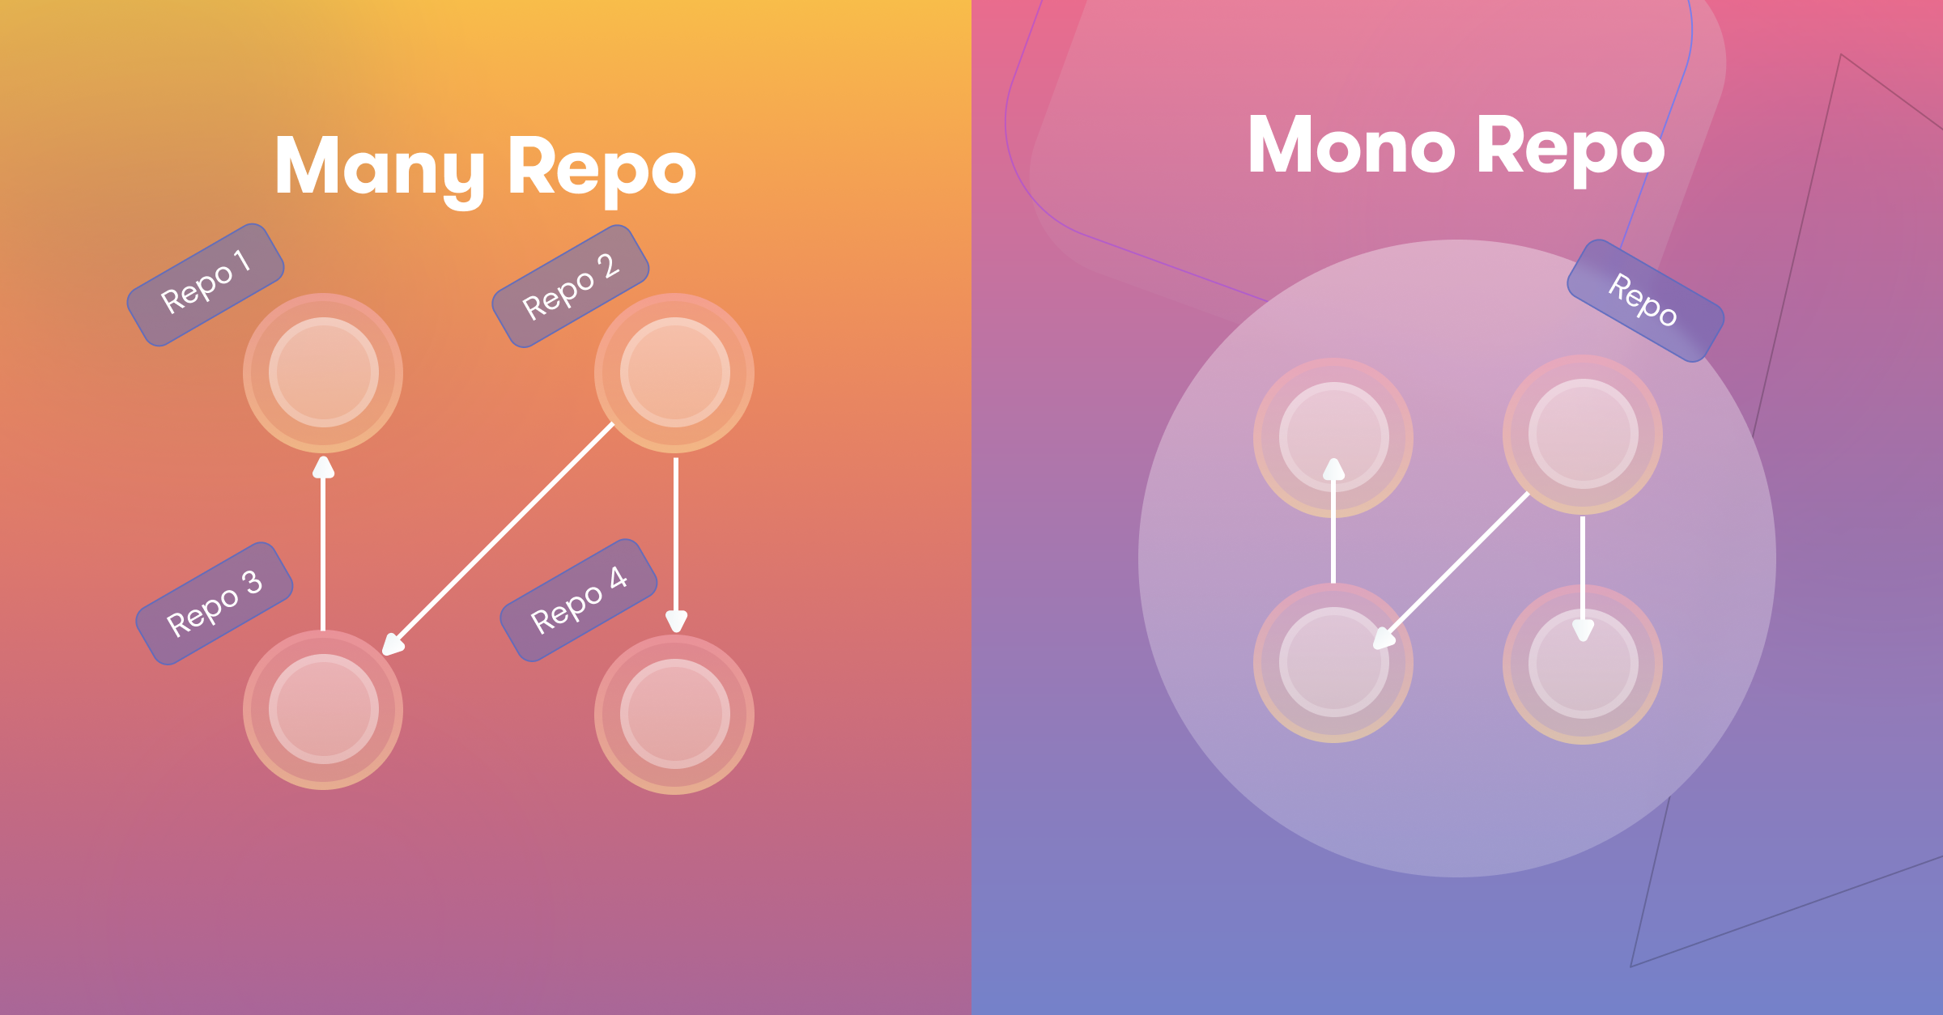
CODEBASE STRUCTURE: MONOREPO vs MANYREPO

Slide 18
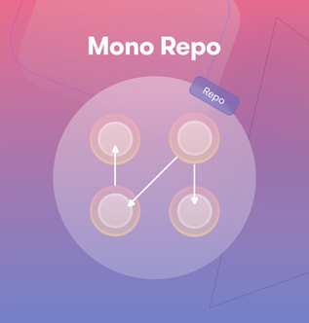
CODEBASE STRUCTURE: MONOREPO APPROACH
All modules are in a single Git repository
Uses local package references (dependencies)
All modules are in same version and deployed together
Pros:
Access to changes immediately by other modules - Good to use new features by other modules - Easier to detect and fix breaking changes
Easier develop, version, test and deploy cycle
Best when:
Small team - A developer work on multiple modules
Modules are more small, frequently changing, well integrated
Suggested for majority of projects, especially in the early stages

Slide 19
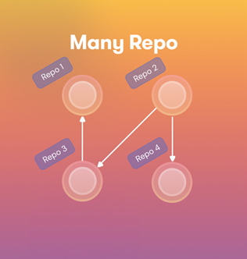
CODEBASE STRUCTURE: MANYREPO APPROACH
Every module located in a separate Git repositories
Uses package (NuGet, NPM, etc) references (dependencies)
Modulare are versioned and deployed separately
Pros:
Independent, more focused development for modules
Cons:
Wait changes on depended modules
Complex to develop, test and deploy
Best when:
Many teams (or departments) specialized on different modules
Modules are mature and boundaries are stable or integration is limited
Considering to move to microservices soon

Slide 20
CODEBASE STRUCTURE: SUGGESTIONS
Always begin with - Monorepo - Single solution
Once the module count and team size increases - Monorepo - Multiple solutions
Preparing to a microservice migration - Multiple Repository - Multiple solutions

Slide 21
UI LAYER: SINGLE / UNIFIED LAYER
Modules only define application services
The Host application contains all the UI pages and components
Pros:
Easy to create pages that uses multiple modules
Simple UI architecture / less infrastructure requirements
Cons:
Ignores modularity on UI level
Notes:
Still ready for microservice migration

Slide 22
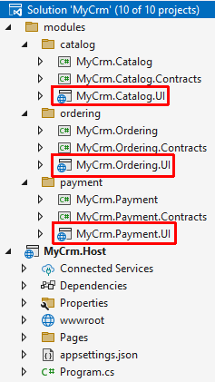
UI LAYER: MODULAR UI
Modules define their own UI pages and components
The Host application contains brings them together
Pros:
Independent, simple UI pages/components
Cons:
Hard to build pages that uses multiple modules
Complex UI architecture / more infrastructure requirements

Slide 23
UI LAYER: HYBRID APPROACH
Independent modules can define their own pages - Example: User management, audit logging, ...
Host application contains pages that uses multiple modules - Example: Reports, dashboards
Modules define components and host application (or other modules) composes them

Slide 24
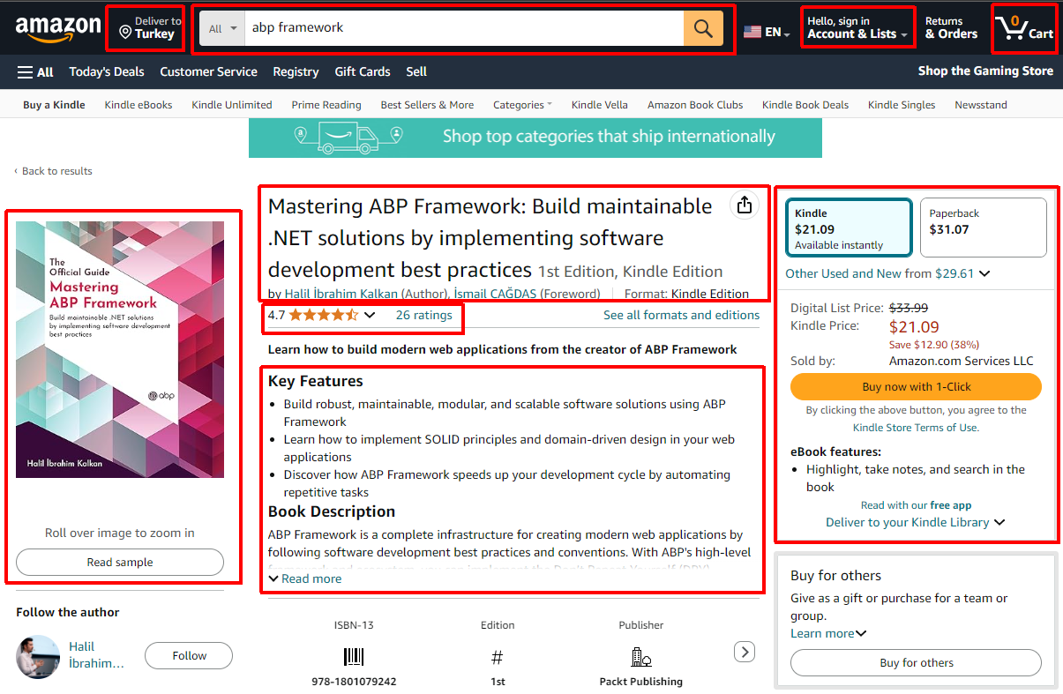
UI LAYER: COMPONENT BASED MODULARITY
Catalog
Stock
Basket
User Ratings / Reviews
Shipping / Delivery
Related / Suggested Items
Search
User account
...

Slide 25
TITLE
TODO

Slide 26
MODULE STRUCTURES
Single project: Only implementation
Two-projects: Implementation + Contracts
Layered project: ...

Slide 27
MODULE DEPENDENCY PATTERNS
TODO: Visualize all
Implementation Dependency (one way) - Module A -> Module B (can fully use) - Good only if A extends B
Implementation Dependency (two way) - Create a shared module between A & B - Create a module C (aggregator) that depends on A & B - Merge modules into a single module
Contracts Dependency - Good if A uses B as a client - Supports one way and two way dependencies - Recommended approach for loosely coupled modules

Slide 28
MODULE COMMUNICATION PATTERNS
Integration Services - Different from application services - Consider performance / implement cache
Events
Database-level transactions - Integration services: Only for read, not manipulate - Manipulation works only in monolith & single database approach - Events: Outbox/inbox pattern

Slide 29
MODULE TYPES
Business modules - Catalog - Ordering - Shipping
Aggregator modules - Reporting / dashboard
Shared / utils modules - Setting management - Permission management - Background jobs
Generic / supporting modules - User & role management - Audit logging - GDPR - Email Sending - Chat

Slide 30
FRAMEWORK REQUIREMENT
Needs a framework to support the modular system.. Why?
...

Slide 31
BEST PRACTICES
Do not introduce breaking changes - Keep backward compatible - Design forward compatible - Mark obsolete and maintain for a few versions
We can use semantic versioning if we use package references for module dependencies
Build unit and integration tests for each module
Manual tests: Create a minimal test host application for each module
Implement Domain-Driven Design ☺

Slide 32
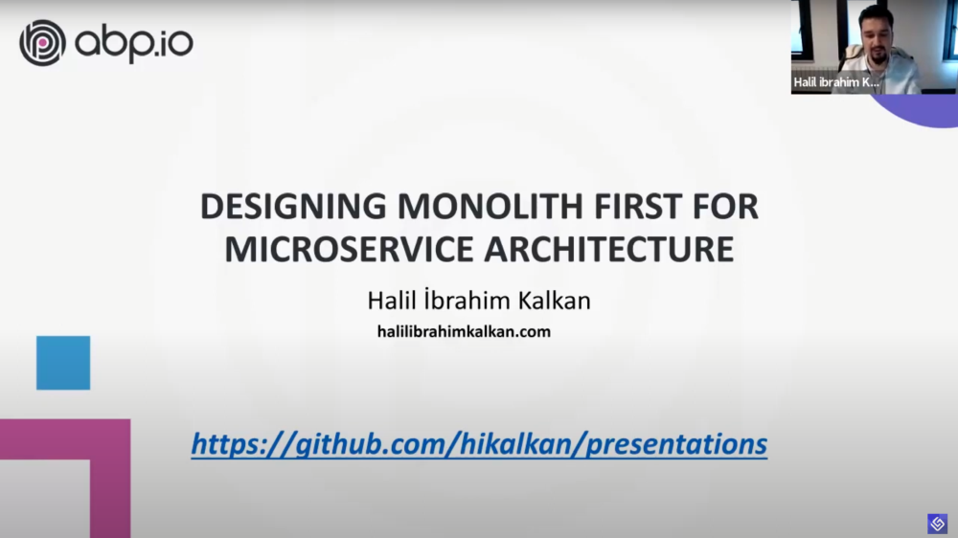


MIGRATING TO MICROSERVICES LATER
Convert modules to services
In-process inter-module communication -> distributed communication - Local method calls -> HTTP API calls - Local events -> Distributed events
Separate databases of modules
Local database transaction -> Distributed transaction
Move the UI out of an API gateway - Design the UI layer as separated
Re-design the authentication flow
Setup development & deployment environments

Slide 33
SUMMARY
...

Slide 34

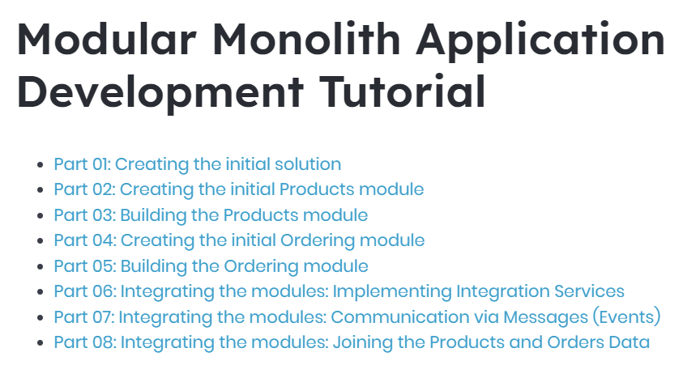
RESOURCES

Slide 35
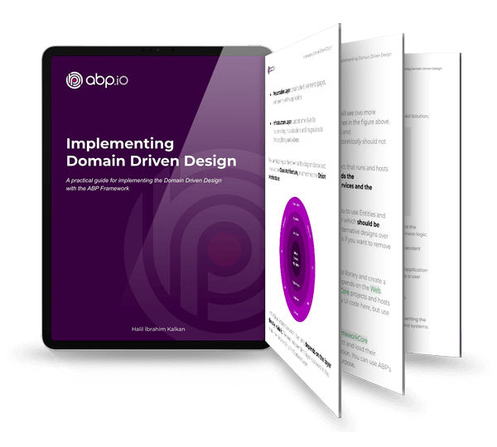

RESOURCES

Slide 36


Download This Presentation
THANK FOR
WATCHING
Halil İbrahim KALKAN
Volosoft, Co-founder
@hibrahimkalkan
@hikalkan

Slide 37
TITLE
TODO

Slide 38
TITLE
TODO

Slide 39
TITLE
TODO

Slide 40
TITLE
TODO

